Slide 1
Object Oriented Programming
Shaimaa esaeed elawady foda .

Slide 2
OOP principles
Inheritance
encapsulation
Abstraction
Polymorphism

Slide 3
Introduction
Instead of using sequential programming and duplicating most of your code ..
OOP [principles] is the best solution for you at a-long time .
OOP Principle is the strategy or style of developing applications based on objects. Anything in the world can be defined as an object. And in the OOPs, it can be defined in terms of its properties and behavior.
Languages that support Object-Oriented Programming are :– C++, Java, JavaScript, C#, PHP, etc. And Languages that are completely Object-Oriented Programming or Pure Object-Oriented are –:
python, Ruby, Scala, etc.

Slide 4
Inheritance
generalization Relationship

Slide 5
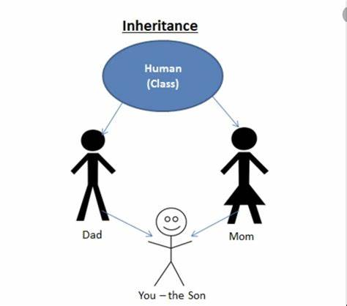
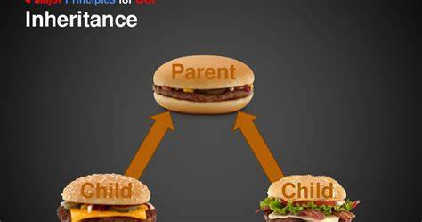
You as child have your-features + your parents inherited features
Inheritance is the method of acquiring features of the existing class into the new class...like genetic-features[carried on DNA] you acquired from you parents .

Slide 6

Let's explain more in programming ..
Suppose there is a class, considered as the parent class, that has some methods associated with it. And we declare a new class, considered as the child class, that has its own methods. So, when a child class is inherited from the parent class then it will have all the methods associated with parent class are available in the child class along with the child class own methods also

Slide 7
Types of inheritance …...
Single Inheritance :
Multilevel Inheritance :
When there is only one derived class.
When there is a level of inheritance. From class A to class B to class C.
Multiple Inheritance :
Hierarchical Inheritance :
When child class is inheriting more than one base class.
When more than one derived class is inheriting one base class.

Slide 8
Encapsulation
Data hiding

Slide 9
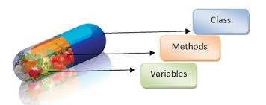
It can be defined as the binding of data and attributes or methods and data members in a single unit. Like putting related things together .
In classes, we have Data and attributes that perform operations on that data. So according to the OOPs principle of Encapsulation, that data can be merged into a single unit <<objects >>.

Slide 10
Features of Encapsulation –
-It provides extra security by the concept of Data Hiding.
-It groups the data and operation in that data into a single unit.
-it prevents code duplication by using single unit every time.
-It attaches an extra security layer to the data and allows to access data only to authorized ones.
- It is used to hide or protect the data from unauthorized access and to control how it is modified so it enhances more security of the data as everything related to a single task must be grouped and access to the data is given as per need.

Slide 11
Abstraction
Knowing what not how!

Slide 12
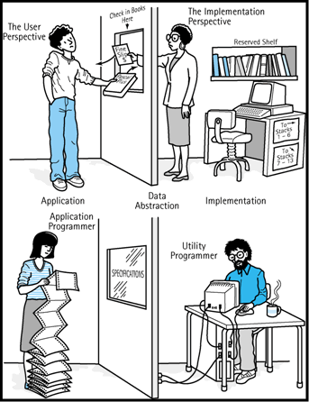
-It can be defined as hiding internal implementation and showing only the required features or set of services that are offered.
-If you had to understand every single function in a big codebase you would never code anything So Instead of focusing on details and complexity of implementing codes …...
just focus on functionality &&results !.

Slide 13

-It focuses on what the code do [ results] ignoring details that showing how it does that result .
-it hides the complexity of coding
Like : using ATM.
-

Slide 14
access modifiers/specifiers :
( keywords that state, from where the (attributes and methods) of a class can be accessed.) is used to control accessibility …
Like..
Public (available for everyone, everywhere ) ,
Private (available only in its class ) ,
protected (available only for its children –derived classes ) ,
Internal (if supported ! means available for its project >>=name space scope ).

Slide 15
Features of Abstraction –
-it protects your data from objects intervention ,unauthorized user as they will not have access to the data. [security ]
-programmers don’t have to change the entire external logic which is there for the user. Just we need to make changes for the methods and it will not affect the functionality.
-it makes learning programming or dealing with it not a hard thing .
-it's the most important principles of OOP

Slide 16
Polymorphism
Same shape ….different output

Slide 17
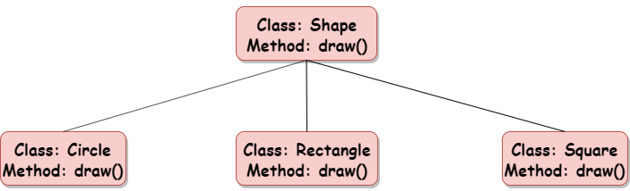
Poly >>= many , morph >>= forms ….
So it's many forms of a thing

Slide 18
-there are 2 types ..
-Compile time polymorphism [static ]
as it's calling in compilation time itself .
-Runtime polymorphism [dynamic ]
as it's calling in execution time .

Slide 19
Compile Time Polymorphism is achieved using Method Overloading.
Method Overloading –
When more than one method is declared with the same name but with a different number of parameters or different data-type of parameter, that is called method overloading.
Runtime polymorphism is achieved using Method Overriding.
Method Overriding –
When more than one method is declared as the same name and same signature but in a different class

Slide 20
Summary
If your code re-useable ,maintenable, more protected ,effective ,flexible ,better in performance ,well organized and well ….
Just use OOP in your code !.

Slide 21
Thank you
shaimaa_esaeed#5757
shimaaesaeed3@gmail.com
Best wishes

